Slide 1

Web-Based Access to Local Hardware: Bridging the Gap Between the Virtual and Physical World
Name: Ayush Patel
Class B Batch 35
En: 22162171038
PID: 781
Problem ID: Access of local hardware through web

Slide 2

Introduction
The integration of web-based technologies with local hardware is revolutionizing the way we interact with the physical world. This presentation will explore the potential of this bridging between the virtual and physical realms.

Slide 3

Challenges
Bridging the gap between the virtual and physical world presents challenges in security, compatibility, and real-time communication. Overcoming these hurdles is crucial for the seamless integration of web-based access to local hardware.

Slide 4
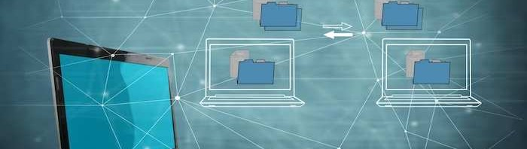
Web-Based API
The development of web-based APIs has empowered developers to access and control local hardware through web applications. This enables the creation of innovative and interactive user experiences that were previously not possible.

Slide 5
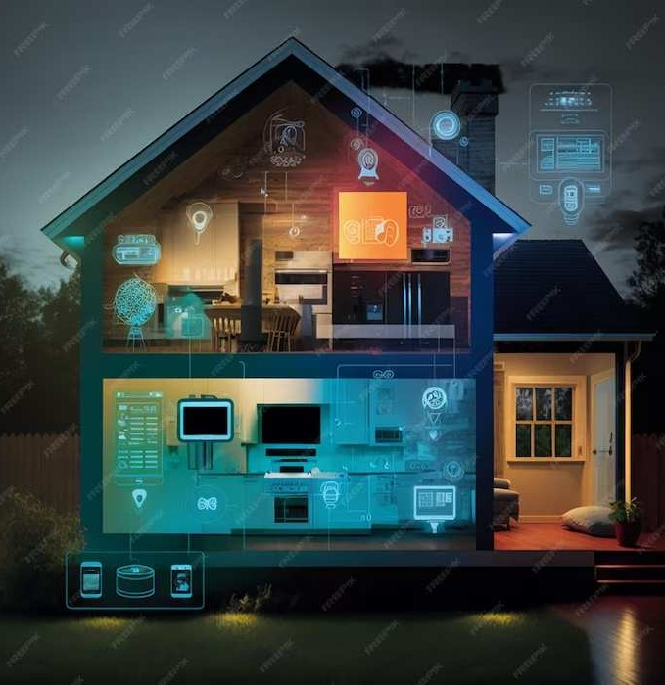
IoT Integration
The Internet of Things (IoT) plays a pivotal role in bridging the gap between the virtual and physical world. By connecting everyday objects to the web, we can enable seamless and intelligent interactions with local hardware.

Slide 6

Real-World Applications
The integration of web-based access to local hardware has transformed industries such as manufacturing, healthcare, and transportation. These advancements have led to efﬁciency gains and innovative solutions.

Slide 7

Security Considerations
As web-based access to local hardware becomes more prevalent, security becomes a paramount concern. Encryption, authentication, and authorization are critical to safeguarding the interaction between the virtual and physical world.

Slide 8
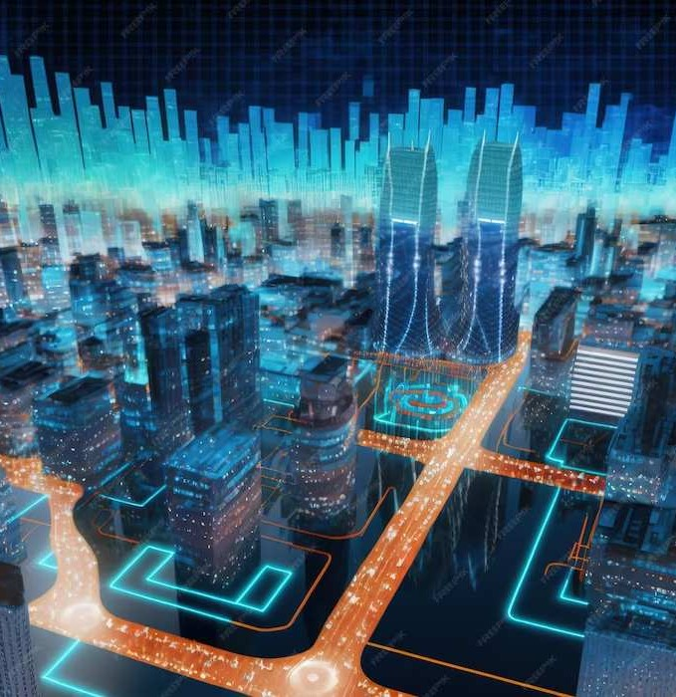
Future Possibilities
The potential for web-based access to local hardware is limitless. From smart homes to autonomous vehicles, the fusion of the virtual and physical world opens the door to unprecedented innovation and convenience.

Slide 9

Conclusion
The convergence of web-based technologies with local hardware represents a paradigm shift in how we interact with the physical world. By overcoming challenges and embracing the potential, we can create a future where the virtual and physical realms seamlessly converge.

Slide 10
Thanks!
Do you have any questions?

